Slide 1

The Thinker
Investigative: The Scholar!
What You Like?
You Enjoy Science & Math
You Are an Analytical Thinker
You Like Working With Ideas
You Prefer to Work Alone
You Prefer Intellectual Jobs

Slide 2
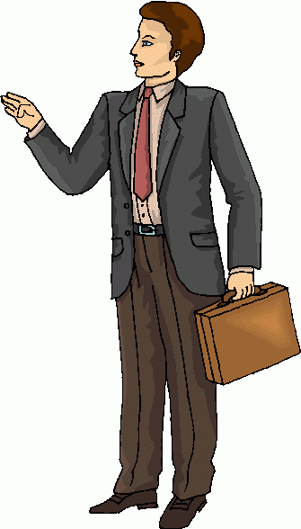
The Organizer
Conventional: The Mr./ Ms Dependable!
What You Like?
You Like Working with Numbers and Data
You Pay Close Attention to Detail
You Enjoy Highly Structured Situations with Clear- Cut Rules.
You Like to keep things Organized
You Prefer a Stable & Secure Job

Slide 3

The Persuader
Enterprising: The Entrepreneur
What You Like?
You Like Selling Things or Convincing Others For an Idea
You Enjoy Leading Others
You Enjoy Speaking in Public
You Like to do work which gives lots of money, power & status
You Prefer a High Profile, Influential Job

Slide 4

The Doer
Realistic: The Physical Person
What You Like?
You Like Working with Tools & Machines
You Enjoy Being Outdoors Even in Extreme Weather
You Like to work with Plants & Animals
You Like Work Which Requires Good Motor Coordination & Dexterity with Hands
You Prefer a Job That Has a Lot of Physical Activity & Hard Work Involved

Slide 5
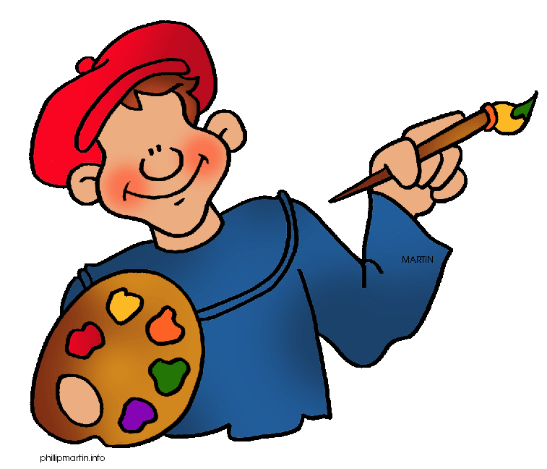
The Creator
Artistic: The Artist
What You Like?
You Like Doing Creative Work
You Enjoy Art, Music, Literature and Poetry
You Like to Toy with an Idea and Express It
You Like to Work in Unstructured Setting with Minimal Rules
You Prefer Working Alone

Slide 6

The Helper
Social: The People Person
What You Like?
You Like Helping Other People
You Have Good Communication Skills
You Enjoy Social Situations
You Like to Work for Social Causes & Individuals Development
You Like to Educate, Inform & Advice People by Understanding their Problems

